Slide 1


APACHE SPARK DEEP DIVE -----SIMPLIFY JOINS--- SHUFFLE join – SORT join – BROADCAST join

Slide 2
How Spark Joins Tables
There can be two scenarios :
a big table with a small table or, instead,
a big table with another big table
And, Everything in between ……

Slide 3

BroadCast Join
Broadcast Hash Join
When 1 of the dataframe is small enough to fit in the memory, it is broadcasted over to all the executors where the larger dataset resides and a hash join is performed.
This has 2 phase, 1. broadcast-> the smaller dataset is broadcasted across the executors in the cluster where the larger table is located. 2. hash join-> A standard hash join is performed on each executor.
There is no shuffling involved in this and can be much quicker.

Slide 4
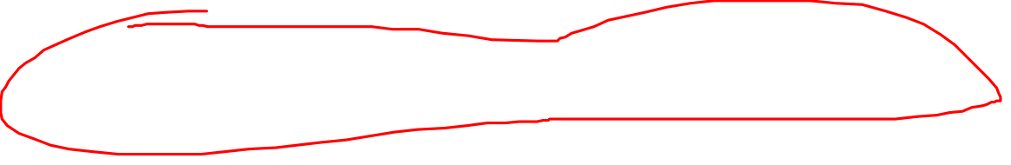
BroadCast Join
spark.sql.autoBroadcastJoinThreshold
This can be configured to set the Maximum size in bytes for a dataframe to be broadcasted.
-1 will disable broadcast join
Default is 10485760 = 10MB

Slide 5
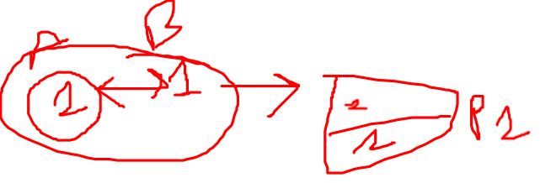
Shuffle Hash Join
Shuffle hash join has 2 phases,
1) A shuffle phase, where the data from the join tables are partitioned based on the join key.
This phase shuffles data across the partitions. The idea here is that if 2 tables have the same keys, they end up in the same partition so that the data required for joins is available in the same partition.
2) Hash join phase: The data on each partition performs a classic single node hash join algorithm.

Slide 6
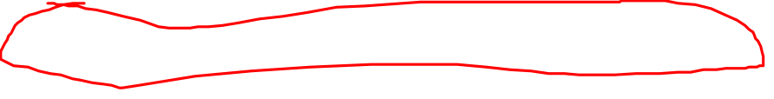
Shuffle Join
Issues:
What Shuffle hash join does is that breaks apart 1 big join of 2 tables into smaller chunks of the localized relatively smaller branch.
Shuffle is a very expensive operation as it involves a lot of network-intensive movement of the data across the nodes in the cluster.
Also, note that the creation of Hash tables is also an expensive operation and is memory bound. This is not well suited for joins that wouldn’t fit in memory.

Slide 7
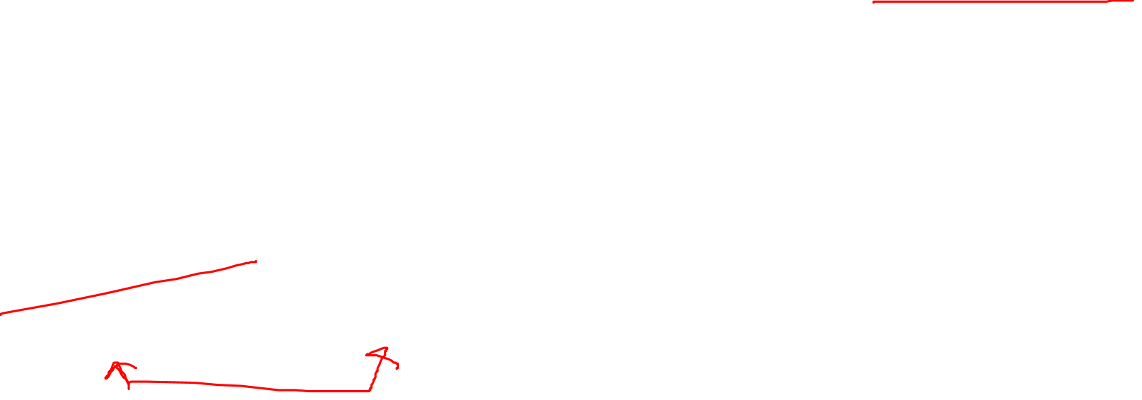
Shuffle Join
Shuffled HashJoin is still useful when :
1) any partition of the build side could fit in memory
2)one table is much smaller than the other one, then cost to build a hash table on a smaller table is smaller than sorting the larger table.
Note : The main thing to note here is that Shuffle Hash join will be used as the join strategy only when spark.sql.join.preferSortMergeJoin is set to false
and the cost to build a Hash Table is less than sorting the data. By default, sort merge join is preffered over Shuffle Hash Join.

Slide 8
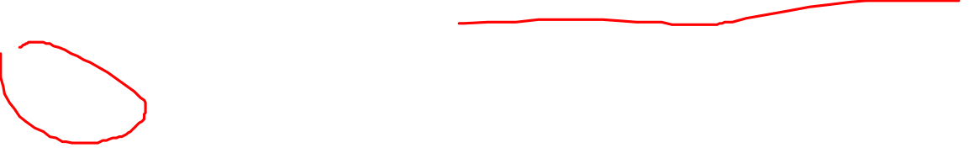
Sort Merge Join
Sort merge join is the default join strategy if the matching join keys are sortable and not eligible for broadcast join or shuffle hash join. It is a very scalable approach and performs better than other joins most of the times.
It has its traits from the map-reduce programs.
What makes it scalable is that it can spill the data to the disk and doesn’t require the entire data to fit inside the memory.
It has 3 phases: 1)Shuffle Phase: The 2 large tables are repartitioned as per the join keys across the partitions in the cluster.
2)Sort Phase: Sort the data within each partition parallelly.
3)Merge Phase: Join the 2 sorted + partitioned data. This is basically merging of the dataset by iterating over the elements and joining the rows having the same value for the join key.

Slide 9

Sort Merge Join
For Ideal performance of Sort-Merge join, it is important that all rows having the same value for the join key are available in the same partition.
This warrants for the infamous partition exchange(shuffle) between executors.
Collocated partitions can avoid unnecessary data shuffle.
Data needs to be evenly distributed n the join keys.
The number of join keys is unique enough so that they can be equally distributed across the cluster to achieve the max parallelism from the available partitions.

Slide 10

Key Takeaways:
Sort-Merge join is the default join and performs well in most of the scenarios.
And for cases, if you are confident enough that Shuffle Hash join is better than Sort-Merge join, disable Sort-Merge join for those scenarios.
However, when the build size(to build the Hash table for Hash Join) is smaller than the stream size, Shuffle Hash join will do better than Sort-Merge join.
Tune the spark.sql.autoBroadcastJoinThreshold accordingly if deemed necessary. Try to use Broadcast joins wherever possible and filter out the irrelevant rows to the join key before the join to avoid unnecessary data shuffling.
Joins without unique join keys or no join keys can often be very expensive and should be avoided.

Slide 11
Thanks and do subscribe to my channel

